Slide 1
VistA Enterprise Refactoring
Transforming to an Open Business Model
OpenMash Team
6/12/2013

Slide 2
Agenda
Needs Analysis & Scope
Refactoring Strategy
VA OIT Enterprise Guidance
Refactoring Plan

Slide 3
As-Is VistA Monolithic Architecture
VistA
Presentation
(roll & scroll)
Business Logic
(remote procedure)
Persistence

Slide 4
VistA Mumps Limitations
Changes to VistA require Mumps coding skills
Hard to find labor
Expensive
Mumps ecosystem cannot leverage open source communities based on modern, standard technology such as Java
Minimal re-use across industries means no economies of scale

Slide 5
As-Is VistA Client-Server
VistA
Presentation
(roll & scroll)
MedSphere Client
RPC
Business Logic
(remote procedure)
Persistence
RPC transport provides access to remote procedures

Slide 6
Client-Server Limitations
Delivering new features beyond simple UI requires both client and server development, same Mumps bottlenecks still apply
Implementing standards requires (re)implementing them in Mumps
Third party apps must each implement an RPC transport stack
Changes to VistA impact all client systems
Changes to Clients are localized to the Client
Hard to manage
Hard to re-use Client innovation
Point-to-point connectivity does not scale with complexity

Slide 7
Vista Architecture Limitations
VistA servers do not scale horizontally
VistA is hard to install, deploy, and manage
VistA does not have native clustering support

Slide 8
VistA Business Limitations
VistA technology limits leveraging existing OSS or commercial technology
Vista point-to-point architecture prevents SOA integration
VistA point-to-point architecture and lack of clustering prevent applying SaaS economies of scale
VistA creates a technology and business bottleneck that slows innovation and evolution

Slide 9
Refactoring Strategy

Slide 10
Virtualization Platform for Innovation
Refactor existing functionality (e.g. Ray Group)
Expose interfaces and API’s
Service Enable legacy technologies
First class transport adaptors for performance (RPC)
Standards based external transport (SOAP, JMS, MLLP)
Standards based data protocols (HL7)
Data transform tools
Delegate responsibility to the Bus
Refactoring provides the stability necessary for change

Slide 11
Enterprise Transformation Strategy
Use Apache OSS integration to ensure open architecture and open business model
Use OSEHRA as the healthcare specific sponsor of the marketplace
Strategy: insert OSS integration as virtualization layer and refactor based on OIT Enterprise IT Principles.
Harness the power of the community with the direction
and guidelines of the OIT EA

Slide 12
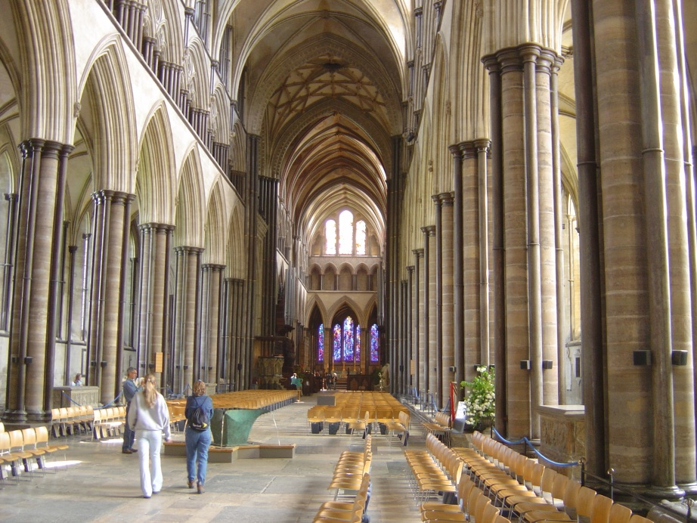
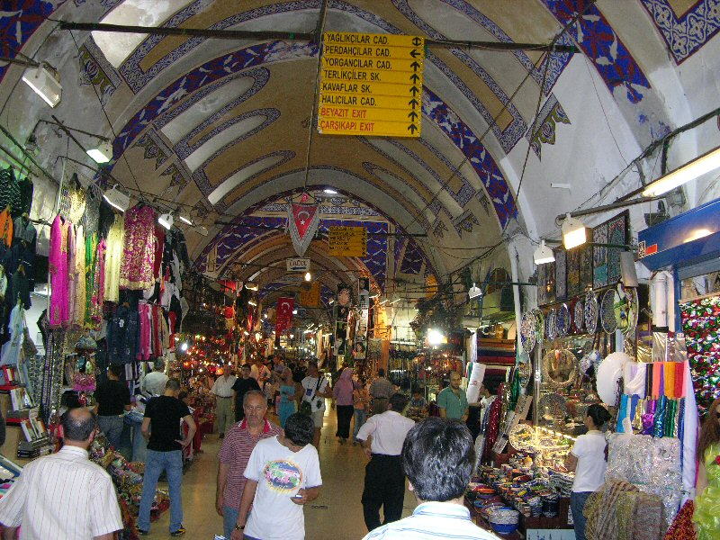


Cathedral and Bazaar
VA
OSS Community
Healthcare
Software Products
& Services
Apache Software
Foundation
OSS Community
General IT

Slide 13
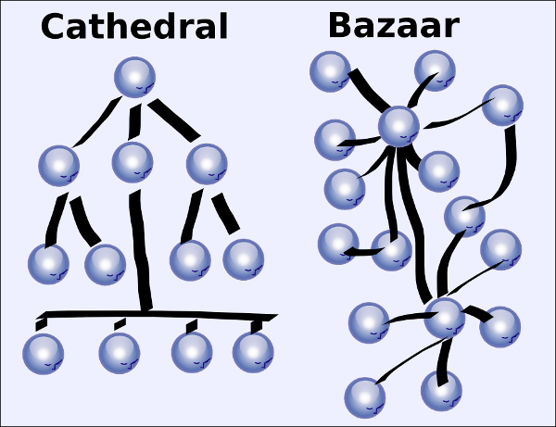
Balancing Innovation & Stability
Necessary
Governance
Necessary
Governance
Necessary
Variation
Emergent
Standards
Standardization
Emergent
Standards
Standardization
Stability
Marketplace
Stability
Marketplace
Evolution requires balancing change and continuity

Slide 14
VA OIT Enterprise Guidance

Slide 15
OIT Enterprise IT Principles
Overview of the VA Target Enterprise Application Architecture (EAA)
Lorraine Landfried DCIO – PD, January, 2012 v1
Separation of presentation, business logic, and data code
Data only accessed through formal messages or APIs
No data stored on end user devices
Web browser is user interface for VA systems
Solutions selected for Lowest Total Overall Cost / Return on Investment
Solutions to be scalable and adaptable
COTS from mainstream vendors able to provide enterprise support
All COTS must be in the TRM
Security designed into all solutions
Information to be shared by rule and withheld be exception
Agile development with deliveries every year

Slide 16
Virtual Layer as a “Green Field”
Overview of the VA Target Enterprise Application Architecture (EAA)
Lorraine Landfried DCIO – PD, January, 2012 v1
Virtual
Services
Legacy / Physical
Systems
Mapping
Virtual Services Layer
Transformation Layer
Physical Services Layer
EAA composed of a stack of hierarchical layers
Virtual Layer serves as a “green field” environment
Physical layer holds legacy systems and infrastructure
Transformation layer maps “green field” virtual environment to “brown field” legacy / physical environment
Provides interoperability between old and new

Slide 17
Definition of Layers
Overview of the VA Target Enterprise Application Architecture (EAA)
Lorraine Landfried DCIO – PD, January, 2012 v1
Only a small part of the stack is built by traditional application development groups
Security will be implemented by multiple groups in accordance with security policies and procedures

Slide 18
SOA Services Layer
Overview of the VA Target Enterprise Application Architecture (EAA)
Lorraine Landfried DCIO – PD, January, 2012 v1
Data
Services
Service
Facades
Legacy
Systems
Business
Services
Physical SOA
Services
Presentation
Services
EAA Virtual SOA Services Layer
EAA Transformation Layer
Physical Systems Layer
Highest level, virtual layer defines VA SOA
Service facade serves as transformation from SOA services to legacy application systems
Physical services also divided into Presentation, Business, and Data Services

Slide 19
SOA Services Level
Overview of the VA Target Enterprise Application Architecture (EAA)
Lorraine Landfried DCIO – PD, January, 2012 v1
Multiple types of services are developed
Each sub-layer has a different type of service
Each type of service is isolated into separate sub layer
Provides both common and dedicated services
Data services are high level, data validation, and authorization
Data access is through Data Layer (described below)

Slide 20
Enterprise Messaging Level
Overview of the VA Target Enterprise Application Architecture (EAA)
Lorraine Landfried DCIO – PD, January, 2012 v1
Enterprise Messaging Level provides logical messaging infrastructure
Not dependent upon the physical transport that
Assume lower layers provide guaranteed delivery and non-repudiation etc.
Defines a standard set of messages to be used to allow services to communicate
A set of standard messages used across the enterprise
Harmonized data element names, syntax, and semantics
Harmonized with VLER and iEHR through the Enterprise Logical Data Model (ELDM)

Slide 21
Logical vs. Physical Messages
Overview of the VA Target Enterprise Application Architecture (EAA)
Lorraine Landfried DCIO – PD, January, 2012 v1
SOA based harmonized logical messages
Possibly simpler for closely related (highly interacting services)
Messages between data, business, and presentation layers will be different
Adapters between internal and external message formats
HL7, NIEM, EDIFACT etc.
External messages implemented in the Interface layer

Slide 22
Data Layer
Overview of the VA Target Enterprise Application Architecture (EAA)
Lorraine Landfried DCIO – PD, January, 2012 v1
Separates SOA Level services (business data) from physical data
Provides access to data for standard messages
Provides standard means for SOA services to access data
Provides COTS access to VA data
Implements Enterprise Data Management Principles

Slide 23
Hardware / OS Environment
Overview of the VA Target Enterprise Application Architecture (EAA)
Lorraine Landfried DCIO – PD, January, 2012 v1
Should provide one or more standard environments in which systems will operate
(e.g., Windows / Linux)
All applications designed to operate in a standard virtual machine
Virtual and physical configurations to be defined by SD&E

Slide 24
Relationship of EAA ADA to iEHR CIIF
Common elements with iEHR Common Information Interchange Framework
Mapping between layers of both hierarchies

Slide 25
Refactoring Plan

Slide 26
Goals
Service enable VistA using OSS Apache Technology
Empower the VistA Community to benefit from the larger OSS community
Align and harmonize with VA OIT EA
Provide a flexible architecture capable of integrating with other VA and DoD integration initiatives

Slide 27
Virtualize VistA with Apache OSS
Virtualization enables macro level refactoring

